Slide 1


Slide 2

CODING MARVELS
MENTOR: Mr. ASHOK.M
Head – Center for Artificial Intelligence
Rajalakshmi Institute Of Technology, Chennai.
Team Member 1: SARANYA M , UG/ ECE Member of
AI Center
Team Member 2: VISHNUDEVI V.S, UG/CCE Member of AI Center

Slide 3
PROBLEM STATEMENT ID: CT-AICS-01
Description:
Development of an NLP Model to guide citizens in filing cybercrime reports on the National Cyber Crime Reporting Portal (NCRP) correctly through a real time analysis of the description and incident supporting media files uploaded by the citizen
PROPOSED SOLUTION:
We propose a keyword-based classification system that automatically categorizes cybercrime case files based on their content. The system:
✅ Extracts text from PDFs and images (scanned documents) using OCR (Optical Character Recognition).
✅ Matches keywords to predefined cybercrime categories (Phishing, Malware, Cyberstalking, etc.).
✅ Moves files into categorized folders for better organization.

Slide 4
SOLUTION OVERVIEW :
.
Our system analyzes the content of case files (PDFs, images, and text files) and classifies them into predefined cybercrime categories. The process involves:
1. Extracting Text
If the file is PDF, text is extracted using PyMuPDF.
If the file is scanned or an image inside a PDF, OCR (Tesseract) converts it into text.
2.. Keyword-Based Classification
The extracted text is scanned for predefined keywords (e.g., “phish,” “fraud,” “malware”).
A scoring system determines the most relevant cybercrime category
3 .Organizing Files
Documents are automatically moved into categorized folders (e.g., Phishing, Malware, Cyberstalking, Banking Fraud).
Unclassified documents are placed in an "Others" folder for review.

Slide 5
Key Benefits of the Cybercrime Classification Project
✅ 1. Automated Case Organization
Eliminates the need for manual sorting of cybercrime reports.
Saves time for investigators and legal teams.
✅ 2. Faster Cybercrime Handling
Helps law enforcement quickly categorize cases.
Enables faster decision-making and prioritization of cases.
✅ 3. Supports Multiple File Formats
Works with PDFs, text files, and scanned images using OCR.
Ensures accessibility for various types of case documents.
✅ 4. No Need for Training Data or AI Models
Uses keyword-based classification, which is lightweight and does not require training datasets.
Simple to implement and modify.
✅ 5. Customizable and Expandable
New cybercrime categories and keywords can be added easily.
Can be adapted for different legal and forensic applications.
✅ 6. Efficient Storage & Retrieval
Organizes case files into folders based on crime type.
Reduces search time when retrieving specific reports.
✅ 7. Potential for Future AI Integration
Can be upgraded to use Machine Learning (ML) and Natural Language Processing (NLP) for better accuracy.
Future versions can detect patterns beyond simple keyword matching.

Slide 6


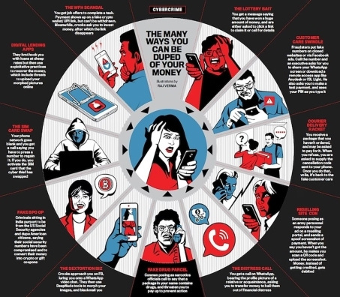





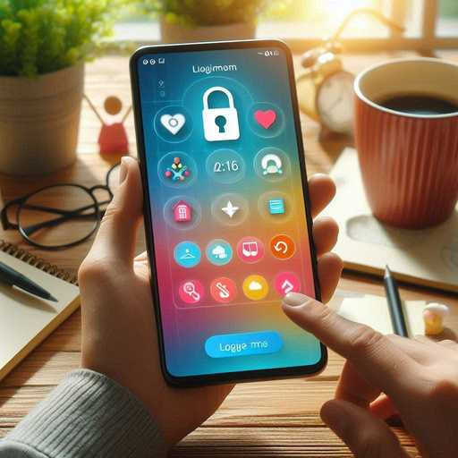
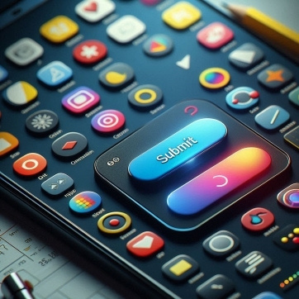


SYSTEM DIAGRAM

Slide 7
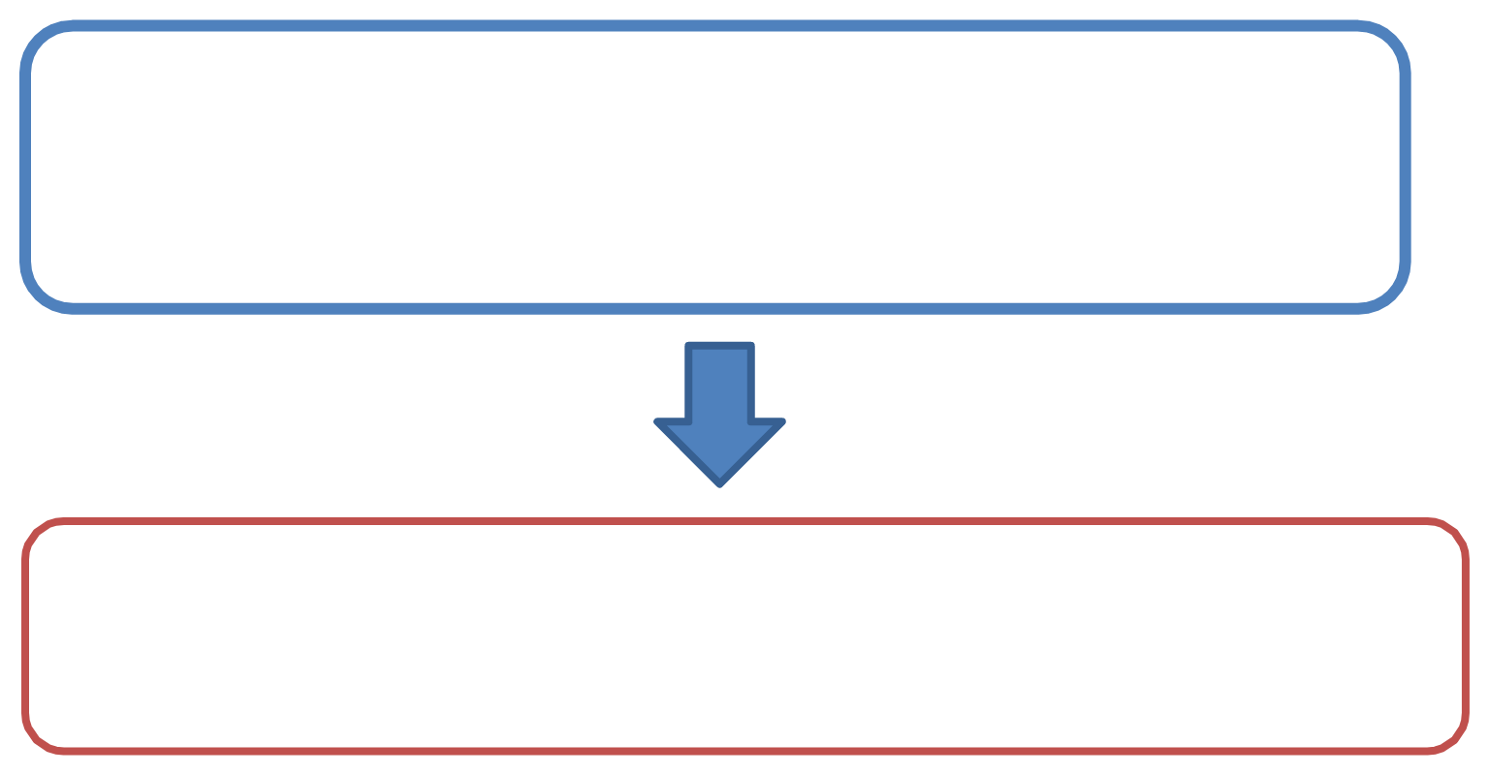










NATIONAL CYBER CRIME PORTAL
CYBER CRIME CLASSIFICATION NLP - BASED REPORTING GUIDE
USER INPUT
AI - BASED NLP MODEL AND
MEDIA ANALYSIS
(TEXT AND MEDIA)
CLASSIFICATION
(OCR, VIDEO AI )
REPORT GENERATION AND VALIDATION
(FINAL STRUCTURED REPORT FOR VICTIM APPROVAL)
REDIRECTS TO NCRP FOR SUBMISSION

Slide 8
TECH STACK
1) Frontend (User Interface):
Frameworks & Libraries:
* HTML, CSS, Bootstrap/Tailwind CSS (for responsive design)
2) Backend (API & Data Processing):
Frameworks:
* Flask / FastAPI / Django (for API development)
* PostgreSQL / Firebase / MongoDB (for database)
3) AI & NLP (Crime Classification & Report Structuring
Libraries & Models:
* spaCy / NLTK (for text processing)

Slide 9
5) NCRP Integration
* If NCRP has an API:
REST API Calls (to auto-submit complaints)
* If no API is available:
Auto-fill structured complaint form for manual submission
6)Deployment & Hosting:
Cloud Services:
* AWS / Google Cloud / Firebase (for hosting & database)
* Docker & Kubernetes (for scalable deployment)
CI/CD (Continuous Integration & Deployment):
* GitHub Actions / Jenkins (for automating deployment)

Slide 10
PROJECT TIMELINE
WEEK 1 : Planning, UI Design & Backend Setup
WEEK 2 : AI Model Development (NLP & OCR Integration)
WEEK 3 : Report Generation & NCRP Integration
WEEK 4 : Testing, Deployment & Final Review

Slide 11
THANK YOU

